Slide 1
Noise
Made by Panyushin Daniil
Group 19Б12-пу

Slide 2
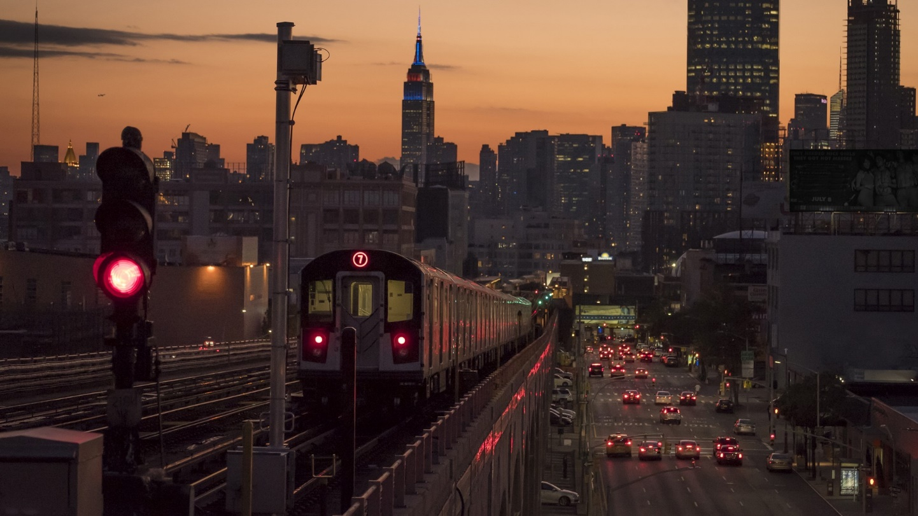
Noises around us
As most of us live in cities or towns we are surrounded with differed noises like:
motors’ roar
sound of train wheels
music
human voices and screams
dogs barking
and so on.

Slide 3
Are noises harmful?
For some humans most of sounds that we don’t notice can be overwhelming. For example sounds of station tickets gate make them feel the same as usual human feels if he hears microphone feedback – most of us don’t like that sound. Such people feels slight pression on their ears as a result of some noises.
Of course various sounds have such an effect on some people. These can be high-frequency sounds or, conversely, low-frequency ones. The second ones are worse for people like above because these noises travel long distances and its’s hard to abate them.
Noises can be not just uncomfortable but harmful. They can cause:
Stress
Cardio-vascular disorder as a result of mental problems

Slide 4

Other point of view
In other hand there are some people which can find pleasant sound that is annoying for others. It can be differend sounds like scratching nails on the board.
For most people loud noises make them feel uncomfortable. But sometimes loud sounds are good – they give us sense of belonging. Good example of such phenomenon is matatus in Kenya – brightly colored buses those are famous for loud music playing inside. It is almost like mobile party and everyone is invited! They make people feel sense of community because everyone listen to the same music unlike in cities in other countries where people use headphones to listen to their own music.

Slide 5
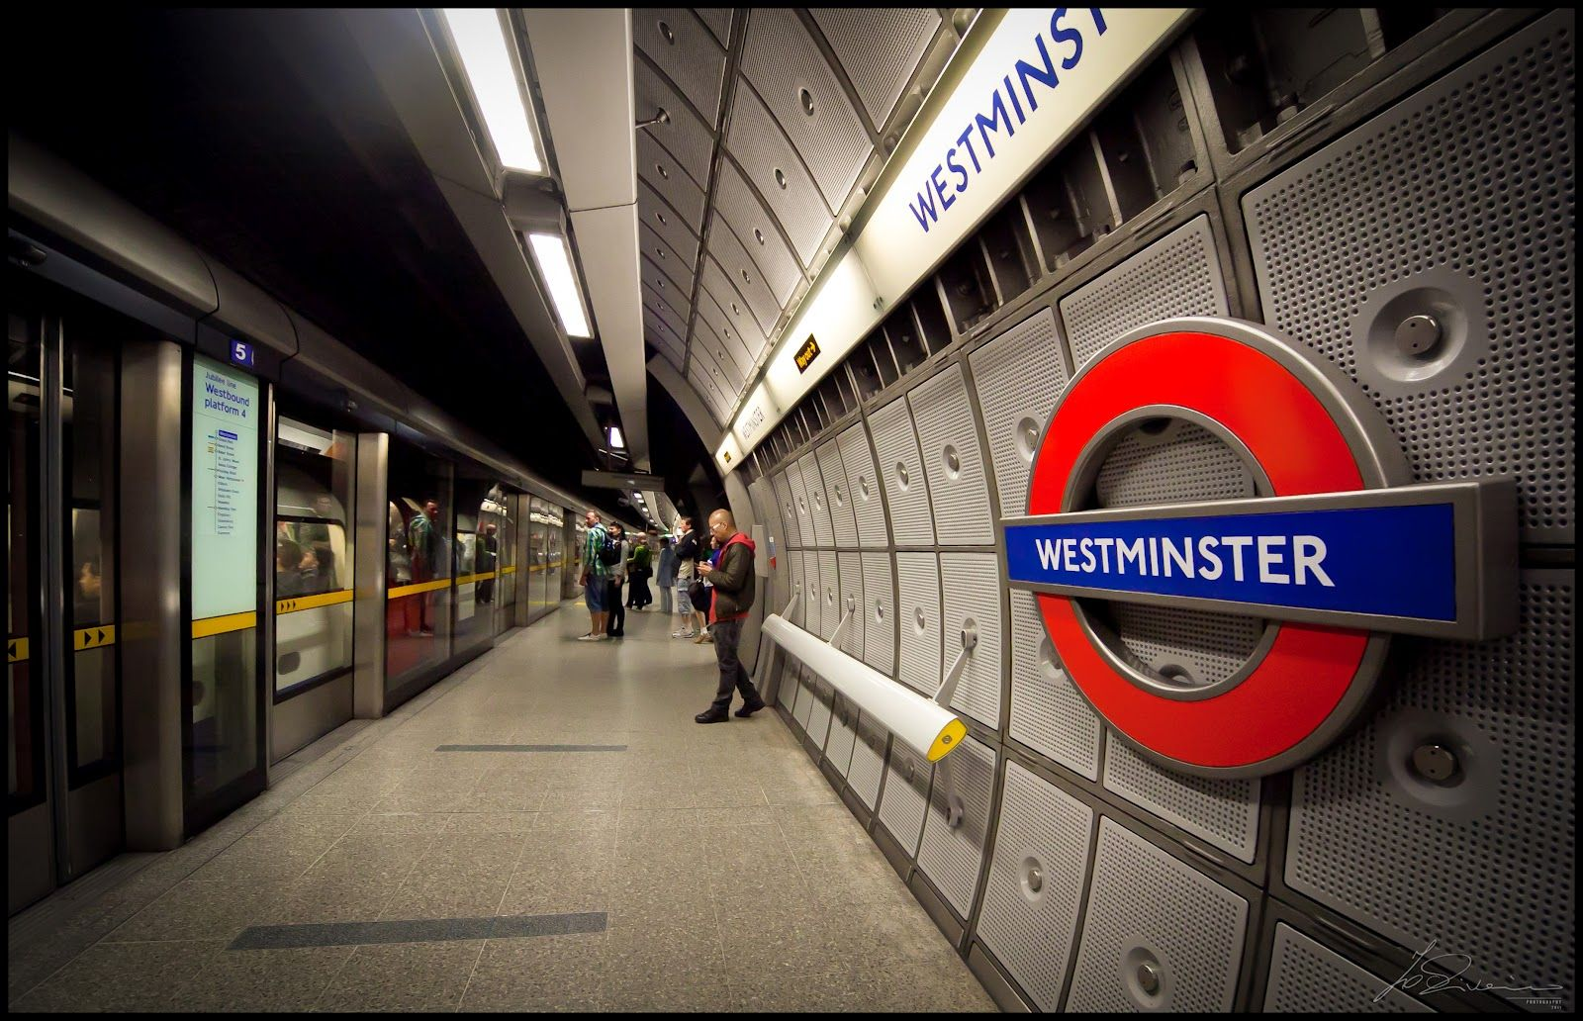
Quiet design
Some places are designed to be quieter than usual analogs. Good example of such architecture is Westminster station of London underground.
On the walls of the station it’s possible to see perforated acoustic panels those absorb noise. There is also special floor construction that also absorbs noise.
In this station people can talk to each other without raising their voices.

Slide 6
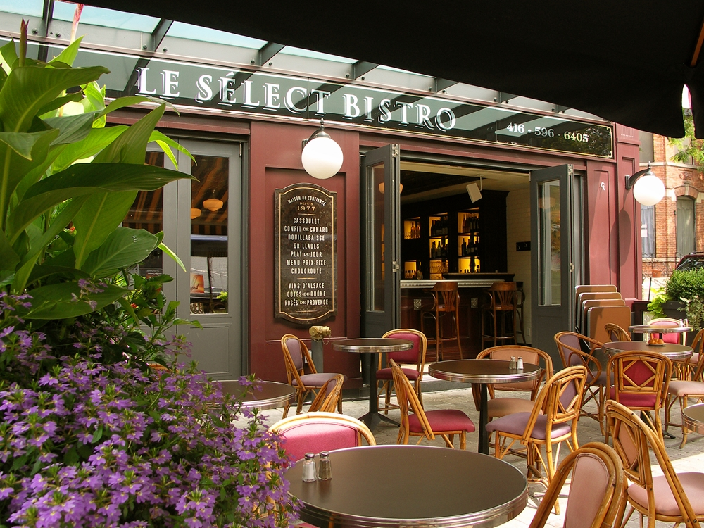
Effect of sound on us while eating or drinking
Psychologists say that right music has a serious effect on our appetite. So, Italian music makes us want to eat pasta or something like that, French music provokes us to drink vine with cheese and baguette. In most restaurants always playing calm music no matter in what part of it you are.

Slide 7
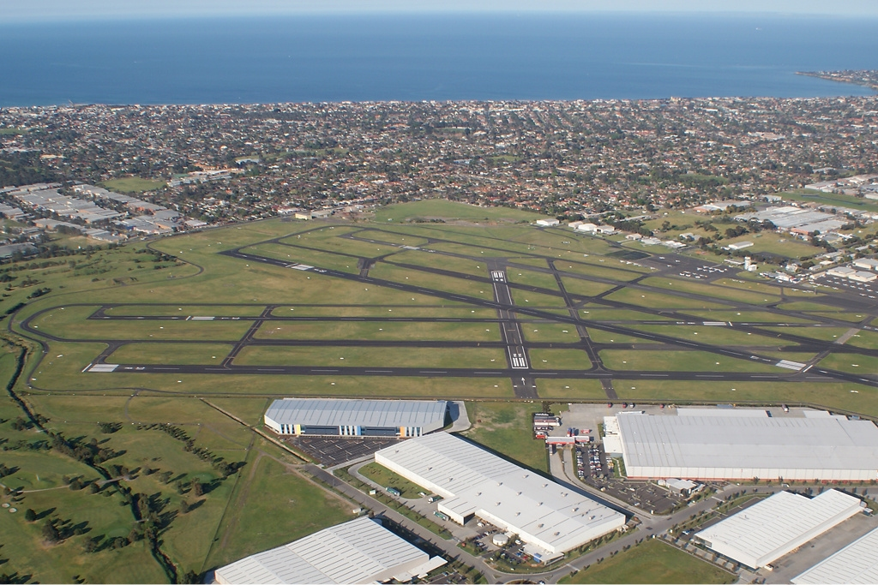
Noise level of our living places
In the past wealthy people lived in quieter suburbs and poorer people lived in city those are louder. But now wealthy people returns back to city because of some reasons.
In big cities there are high rise candles those are far from the ground and it’s possible not to hear street sounds from in them.
Another reason is airports – nowdays all big cities have airports those are situated near the city – in suburbs. Such situation raises noise level of people in suburbs because planes always flying over their houses.

Slide 8
Questions to the audience
Do you have some problems with noise perception?
When was the last time you felt sense of community when you heard some noises?
Have you ever been to quiet subway station?
Is it noisy in the place where you are live?
How many planes fly over your house every day?

